Slide 1
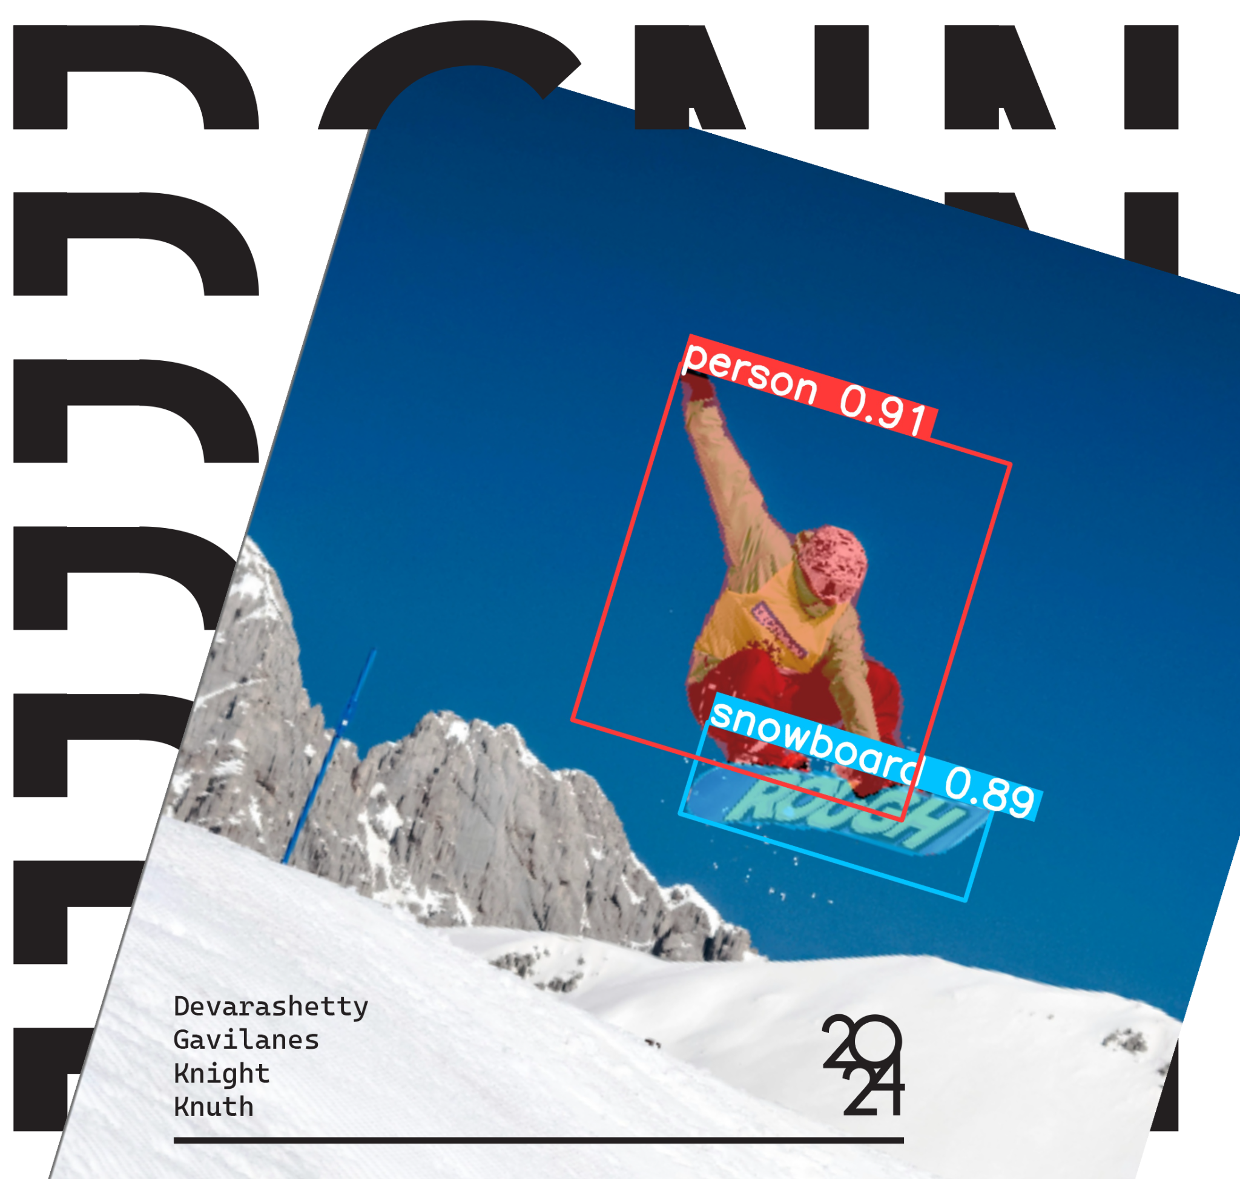
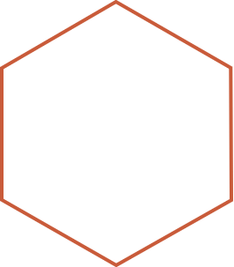

Computer Vision:
Object Detection using Faster R-CNN, Mask R-CNN, and YOLOv8
Hector R. Gavilanes, Project Lead
Jacob Knight, Deep Learning Architect
Kyle Knuth, Data Scientist
Sai Devarashetty, Software Engineer

Slide 2
Agenda
Introduction
Architecture
Overview
Analysis
Results

Slide 3
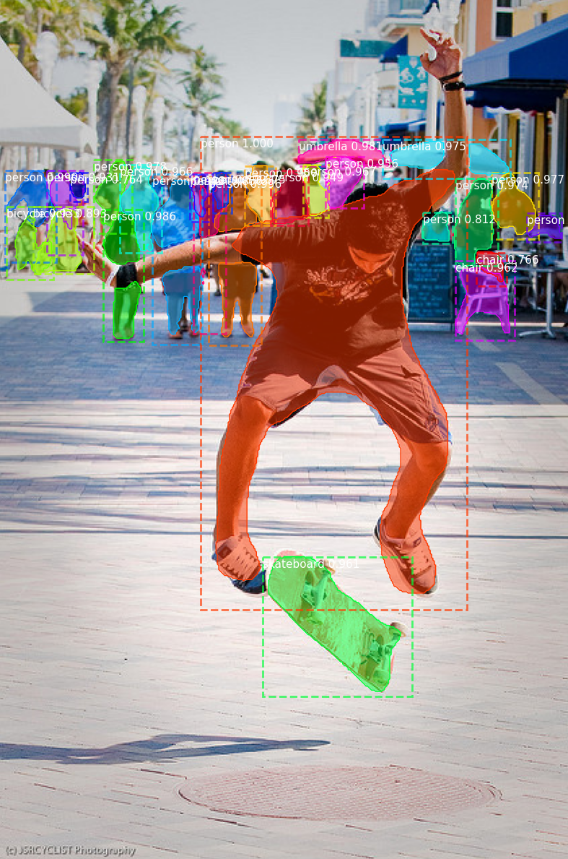
Introduction
Our study compares
Faster R-CNN, Mask R-CNN, and YOLOv8
object detection and segmentation evaluating accuracy and speed.
Our findings help choose the best method based on performance and practical deployment.

Slide 4
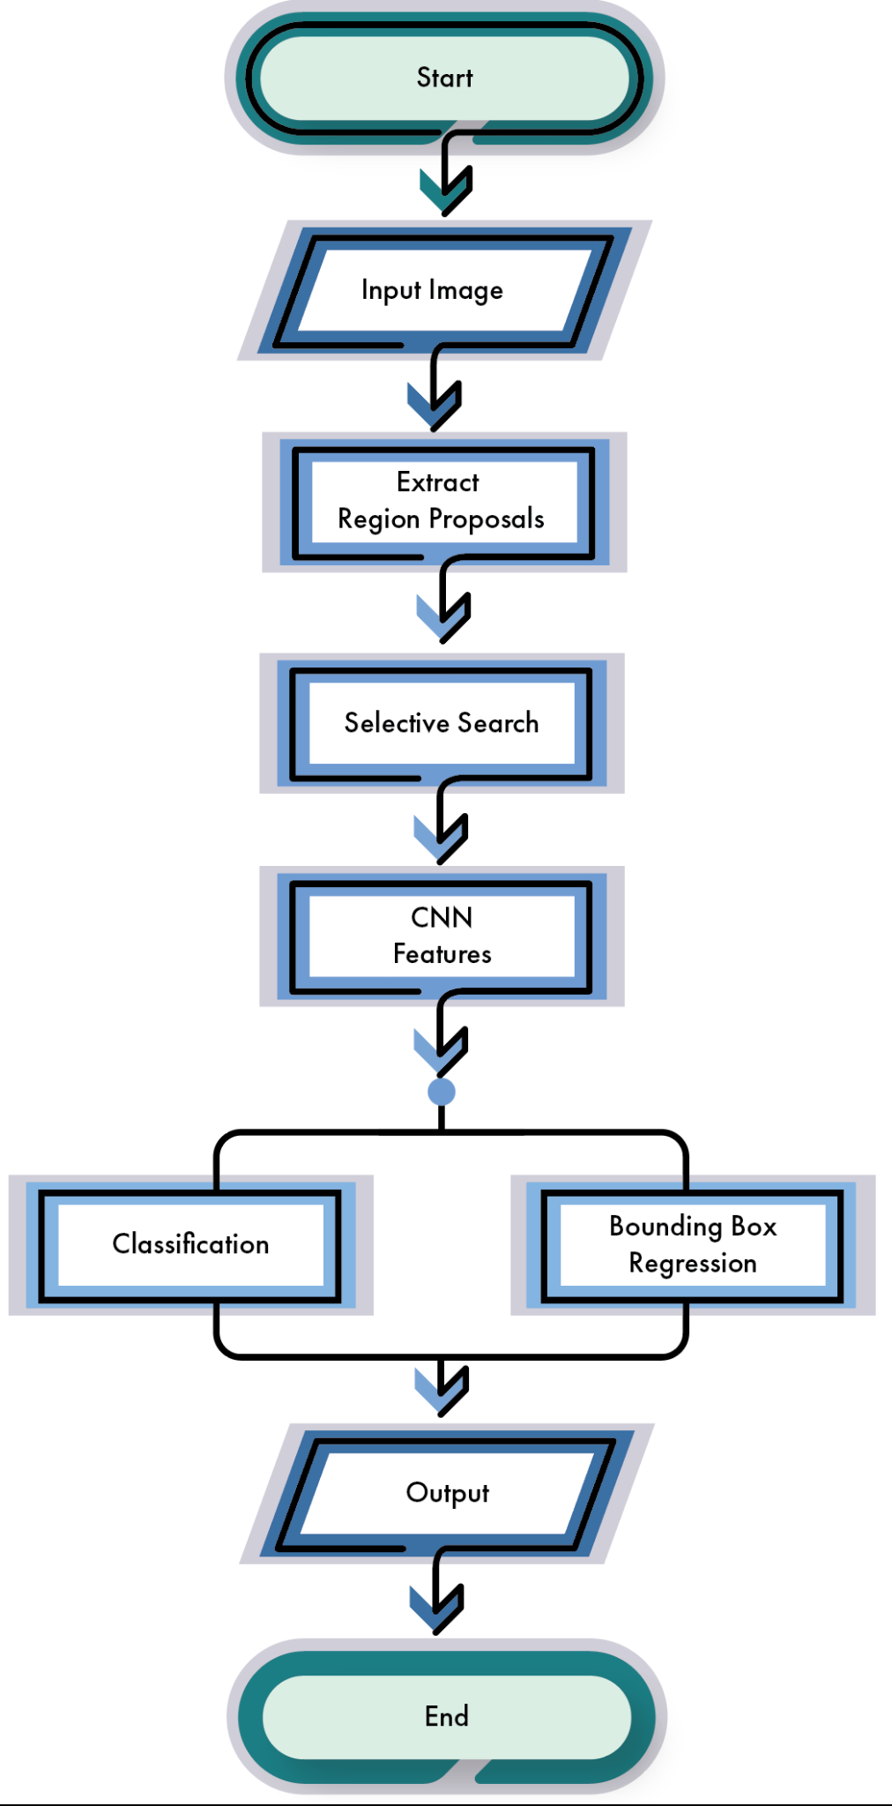
R-CNN: Architecture
Multiple Region Proposal
Feature Extraction
Selective Search
Classification
Bounding Box regression

Slide 5
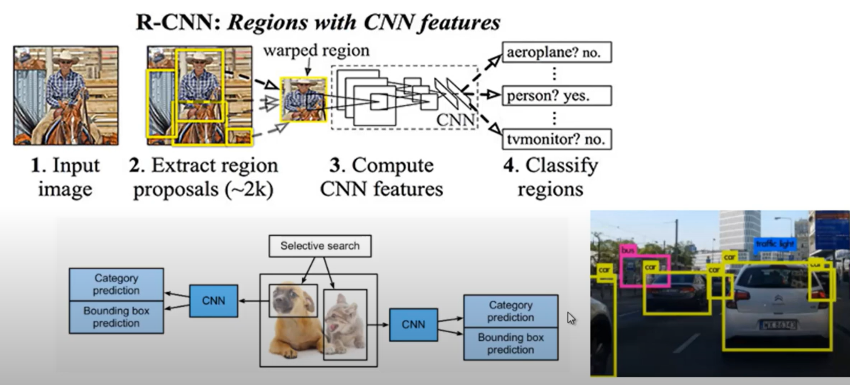

Slide 6
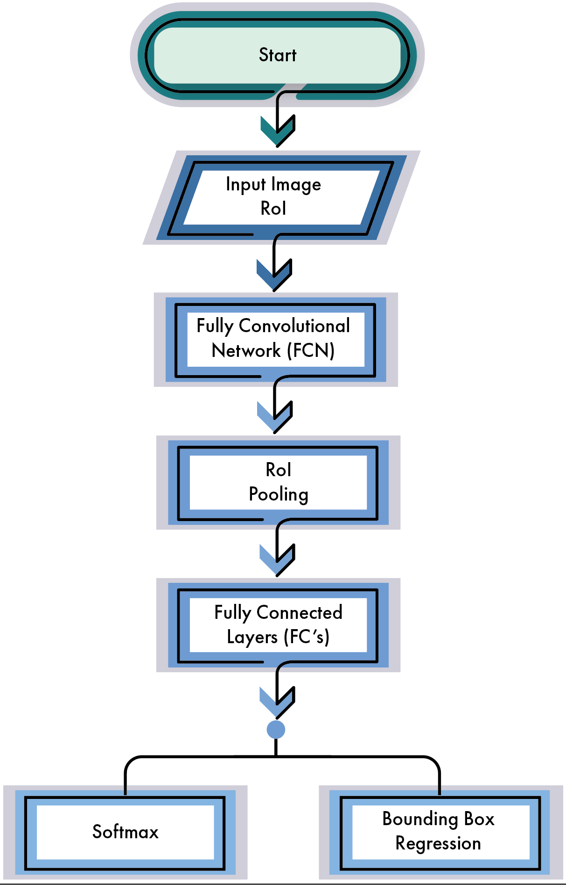
Fast R-CNN: Architecture
Region Proposal Generation
Fully Convolutional Network (FCN)
RoI Pooling
RoI Feature Vector
Feature Extraction
Entire image process

Slide 7
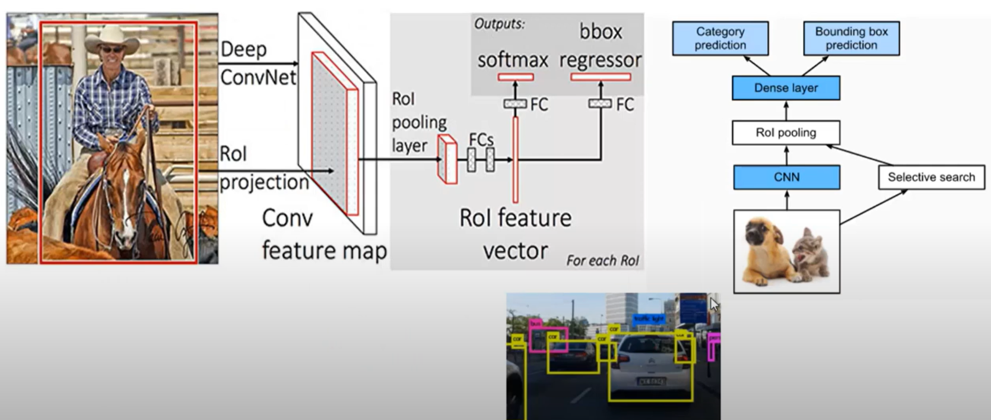

Slide 8
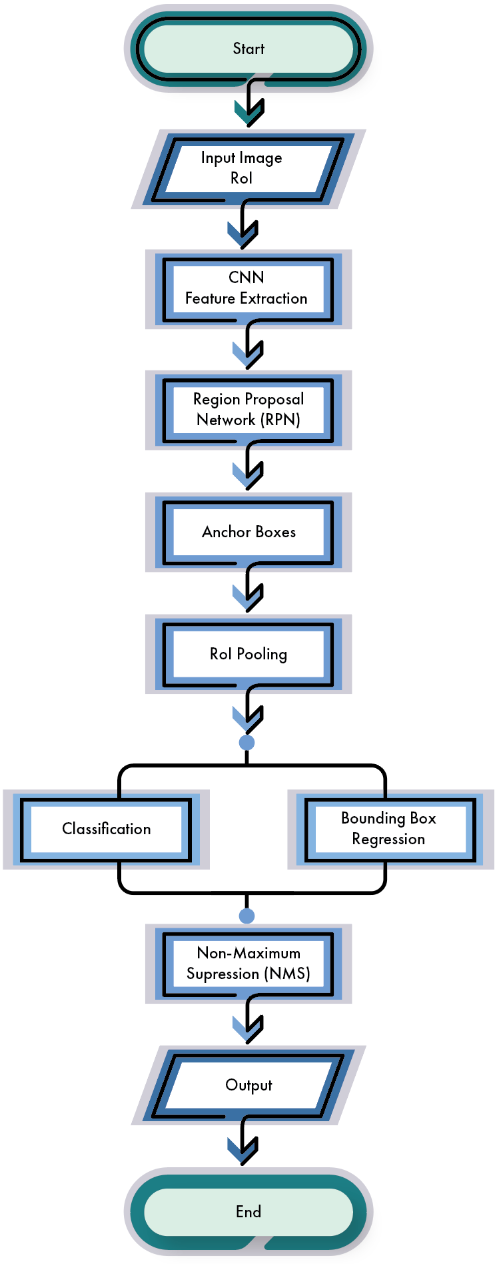
Faster R-CNN: Architecture
Feature Map
Region Proposal Network (RPN)
RoI Pooling
Anchor boxes
Classification & Bounding Box Regression
Non-Maximum Suppression (NMS)

Slide 9
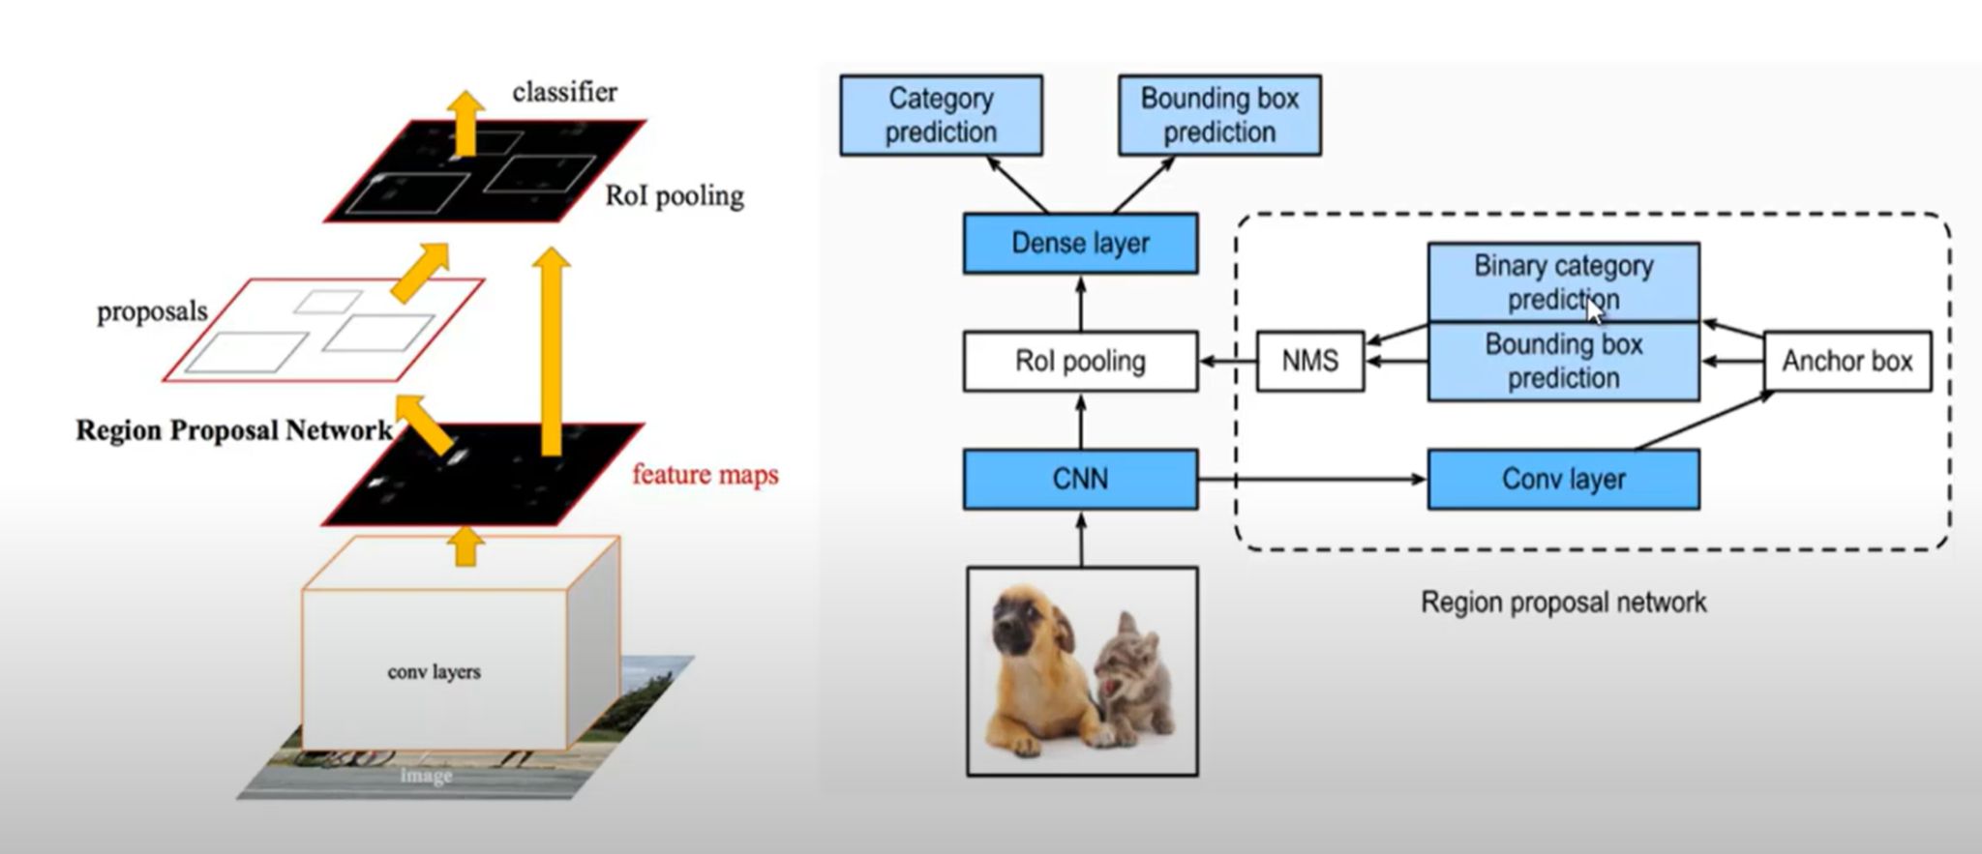

Slide 10
Advantages of
Faster R-CNN
Efficient Region Proposal Generation
End-to-End Training
High-Quality Proposals
Practical Implementation

Slide 11
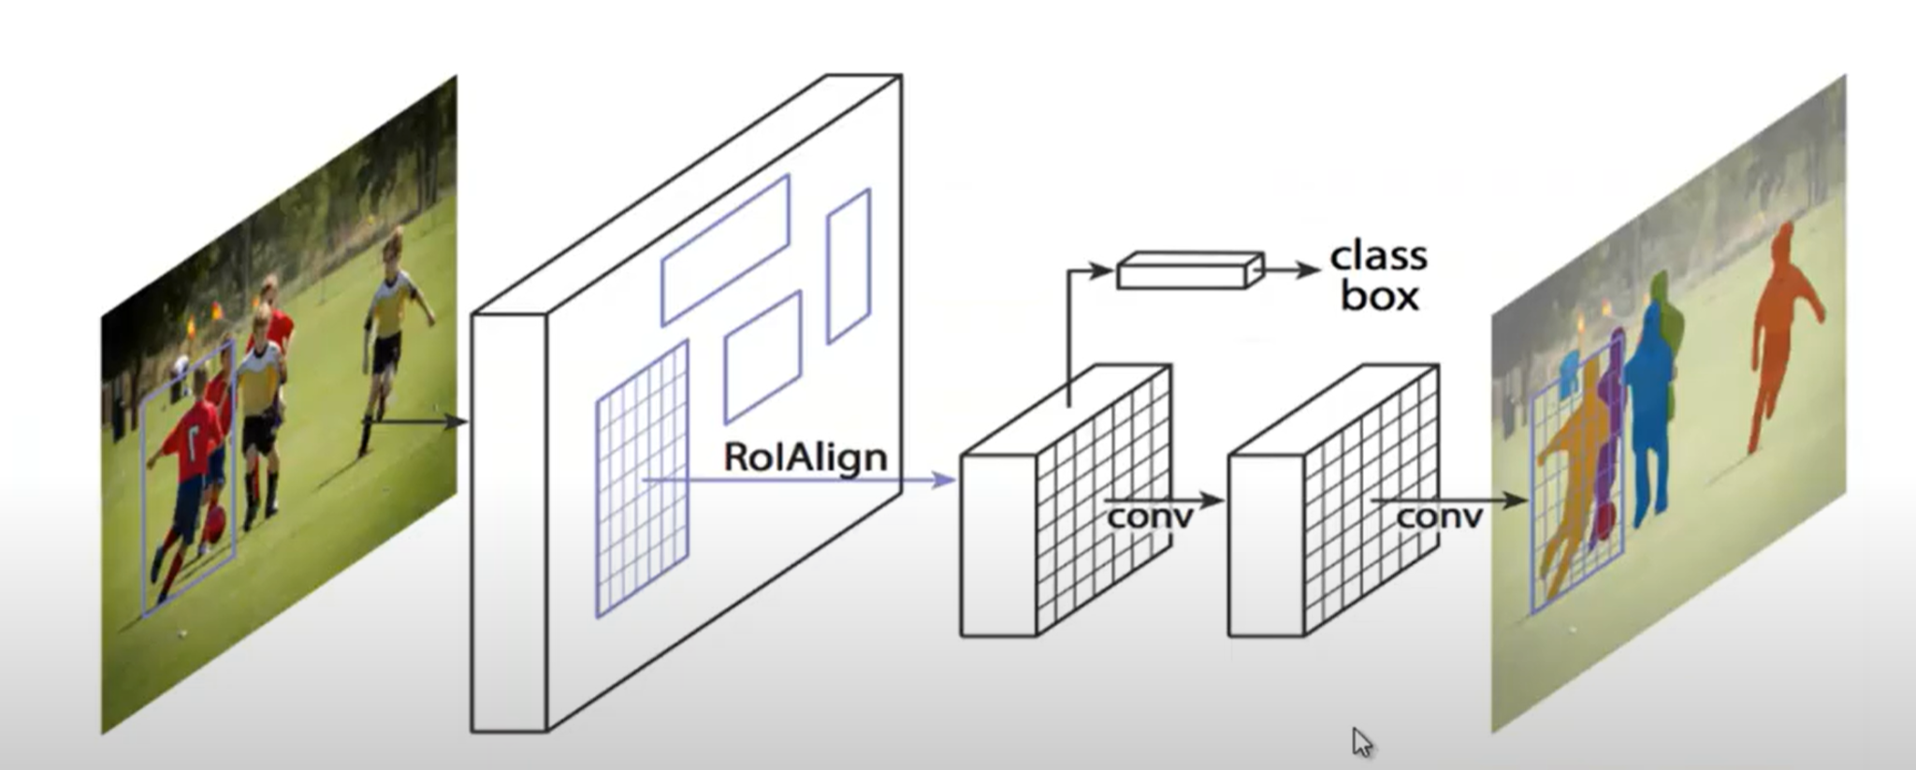
Mask R-CNN: Architecture
Backbone CNN
Region Proposal Network (RPN)
Anchor Boxes
Region of Interest Align (RoIAlign)
Pixel-level precision
Preserves spatial information
Precise alignment

Slide 12
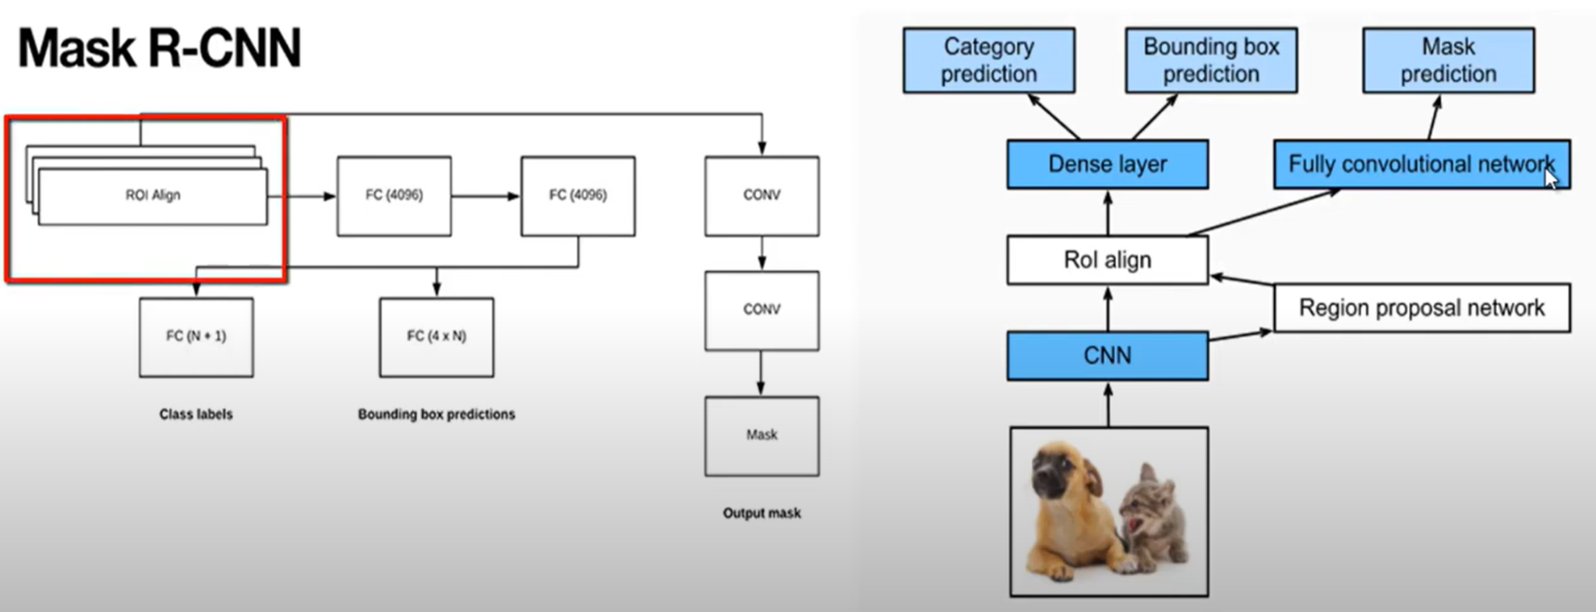

Slide 13
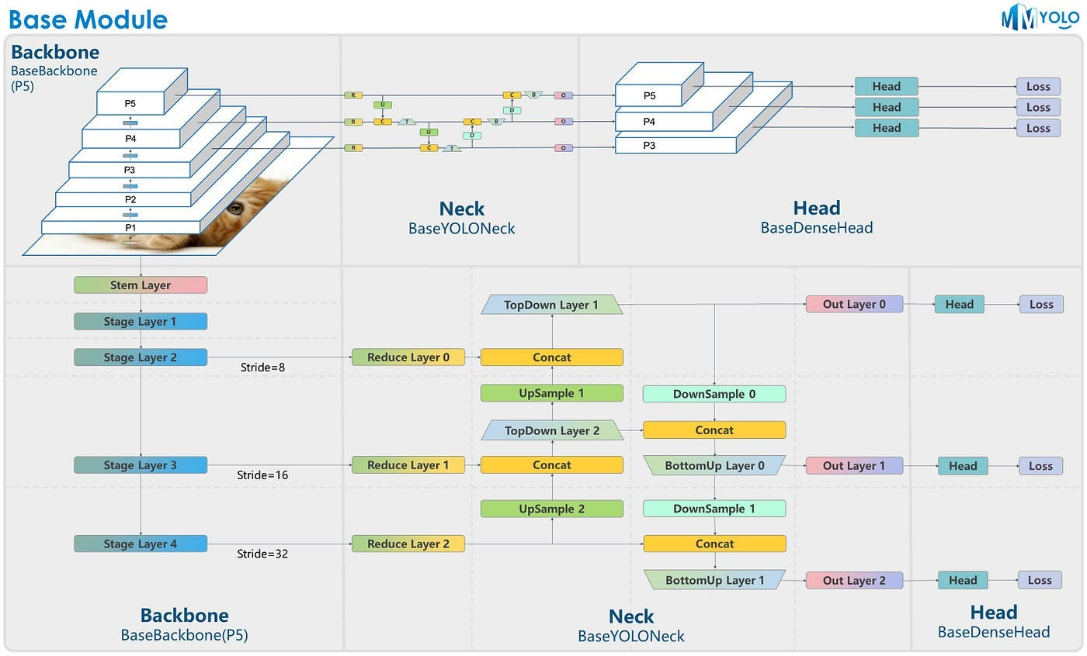
YOLOv8: Architecture
Center to Front (C2F) Module
Keeps the model lightweight
Capturing gradient information
Center sampling
Anchor-Free Model
Non-Maximum Suppression (NMS)
Loss Function
Complete IoU (CIoU)
Distribution Focal Loss (DFL)

Slide 14
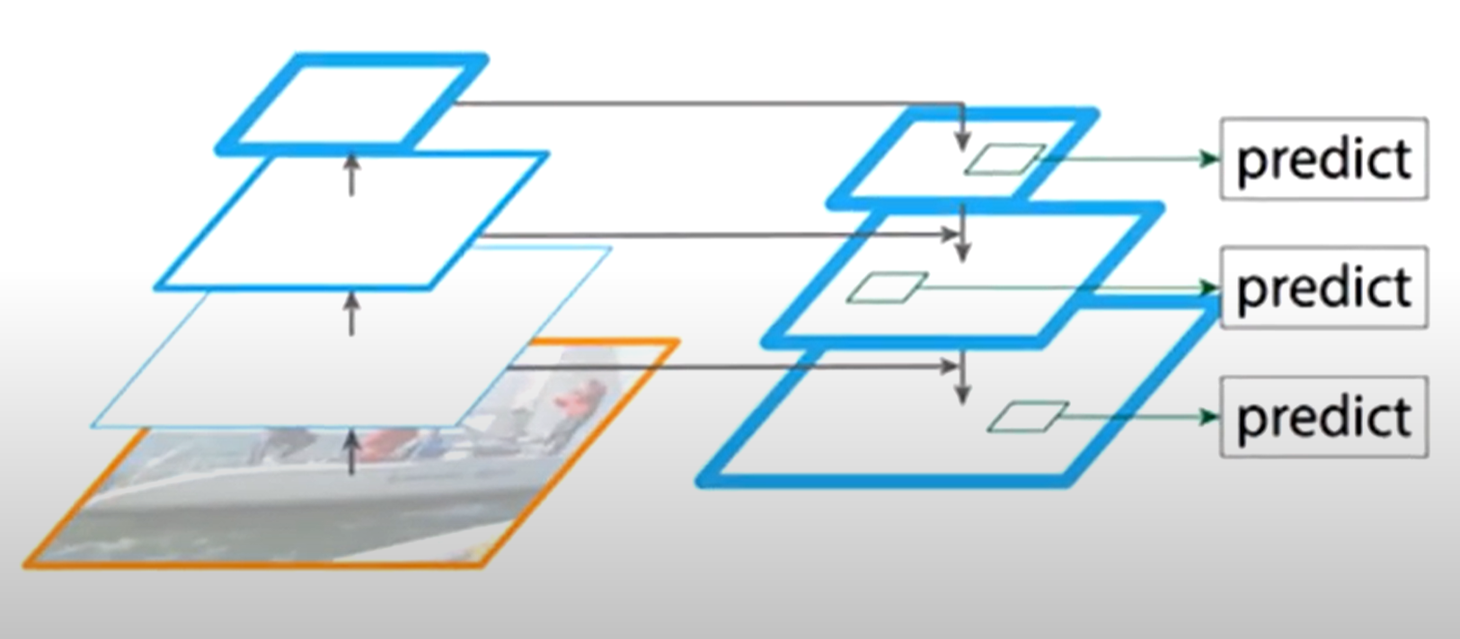
Feature Pyramid Network (FPN)
Bottom-Up Pathway
Traditional CNN & Pooling
Feature Pyramid
Top-Down Pathway
Fuses Multi-scale Features
High & Low resolution

Slide 15
Advantages of
YOLOv8
Real-Time Object Detection
Quick and Accurate
Small object detection

Slide 16
Overview of Models
R-CNN
Fast R-CNN
Faster R-CNN
Mask R-CNN
YOLOv8
Introduced selective search for generating region proposals.
Slow inference due to processing each region independently.
Not end-to-end trainable.
Introduced Region of Interest (RoI) pooling for efficient feature extraction.
Shared convolutional features for the entire image.
Faster inference compared to R-CNN..
Introduced Region Proposal Network (RPN) for generating region proposals.
End-to-end trainable.
Achieves faster inference than Fast R-CNN.
Extends Faster R-CNN by adding a parallel branch for mask prediction.
Provides pixel-level segmentation alongside object detection.
Enhances understanding of object shapes and boundaries.
Single-stage object detection model.
Divides the input image into a grid and predicts bounding boxes and class probabilities directly.
Known for real-time inference speed..

Slide 17
Overview of Project
Datasets utilized
Challenges
Performance comparison
Conclusion
COCO dataset: Large-scale dataset for object detection, segmentation, and captioning tasks.
Custom dataset for military tank detection.
Custom dataset for
SAM.
Robustness to environmental variations.
Mislabeling of objects.
Model stability during training.
Evaluation metrics: Accuracy, speed, robustness.
Benchmarking on standardized datasets like COCO.
Each model has its strengths and weaknesses.
Choice of model depends on specific requirements such as speed, accuracy, and deployment..

Slide 18
Areas of focus
Performance evaluation
Resource Efficiency
Algorithmic Enhancements
Implementation
Real-World Applications

Slide 19
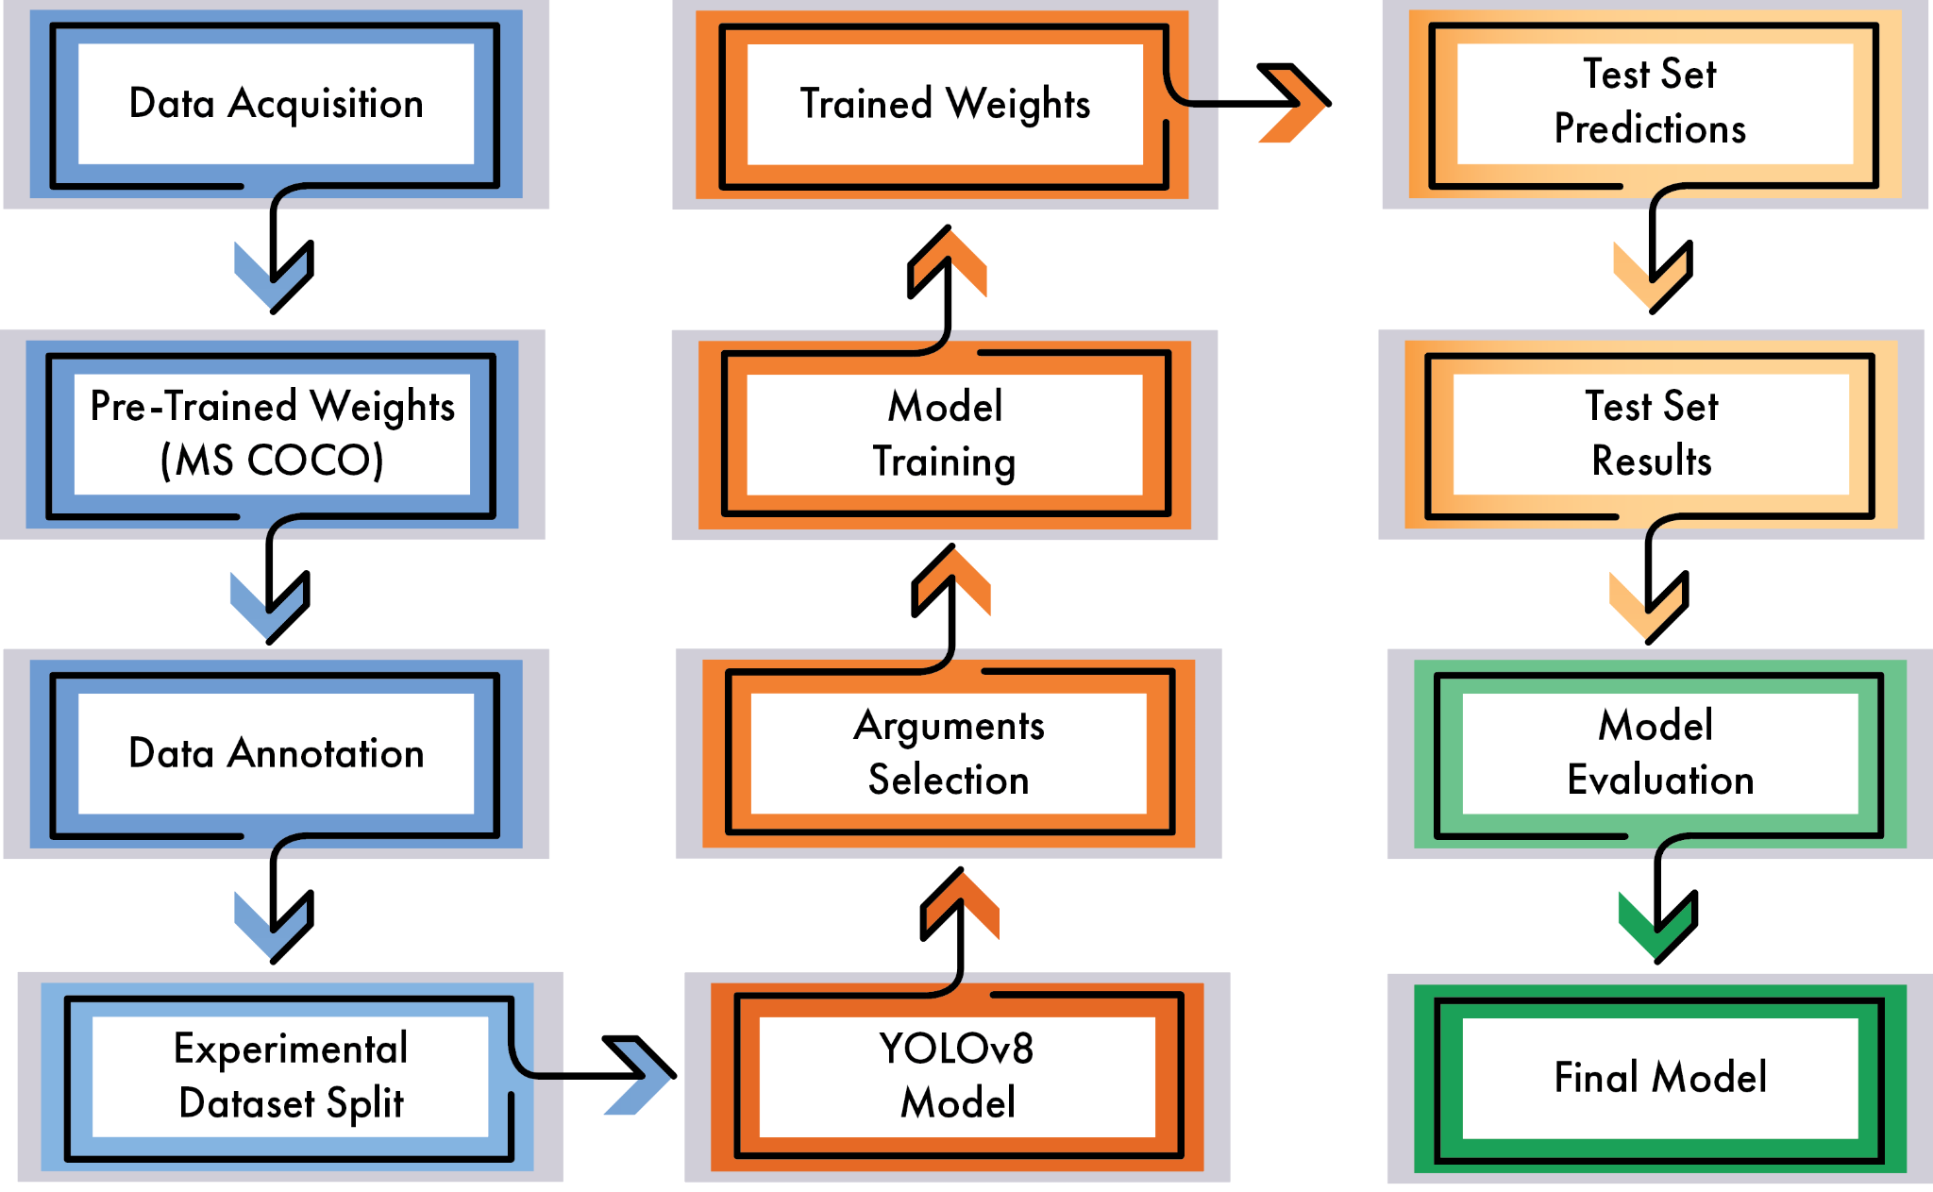
Analysis

Slide 20
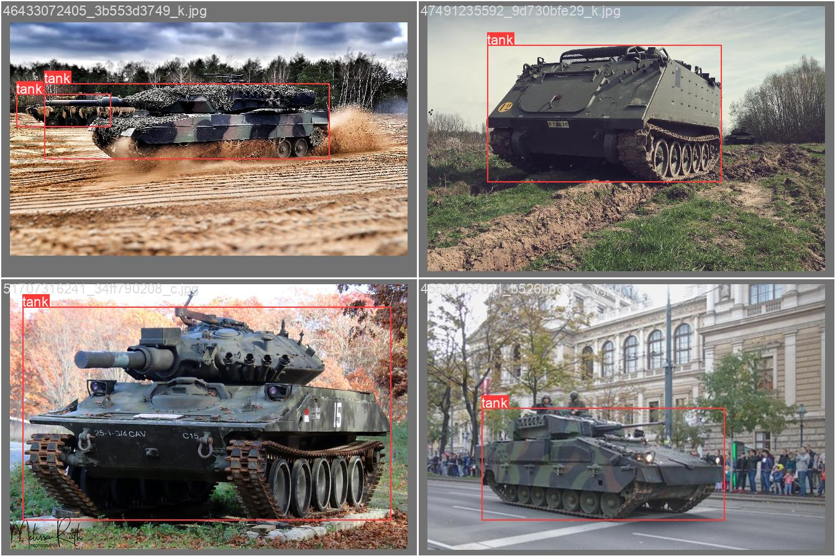
Training

Slide 21
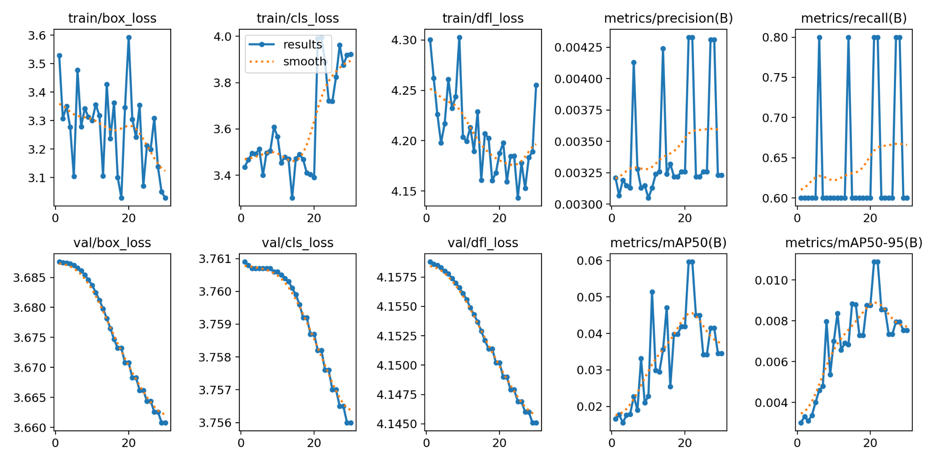
Performance

Slide 22
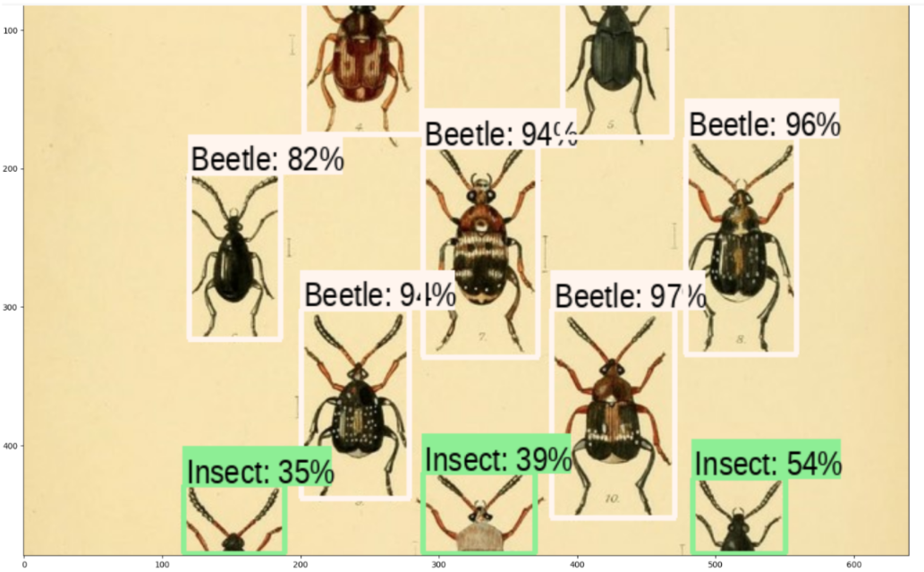
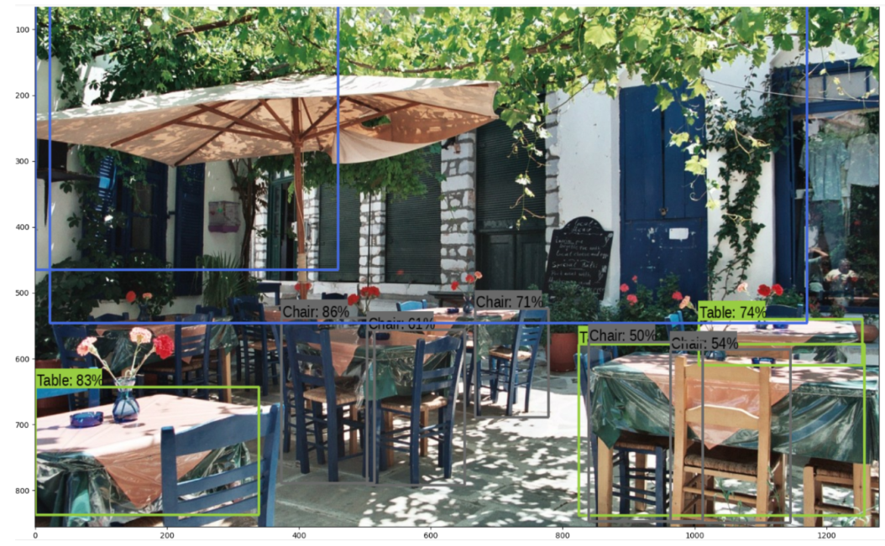
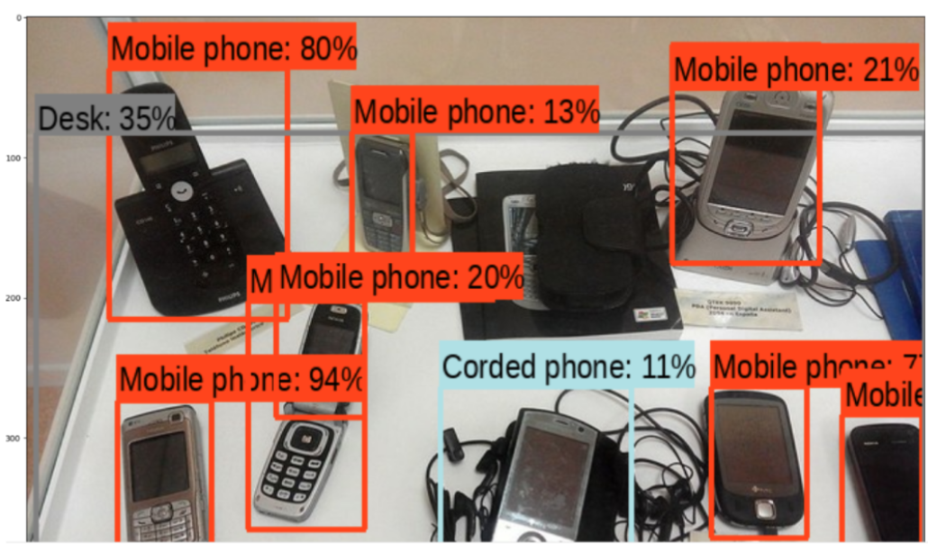
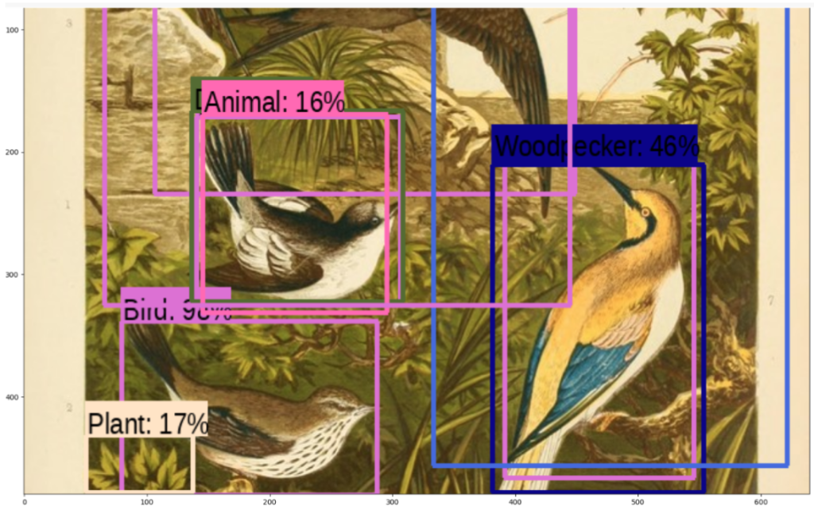
Results of Faster R-CNN

Slide 23
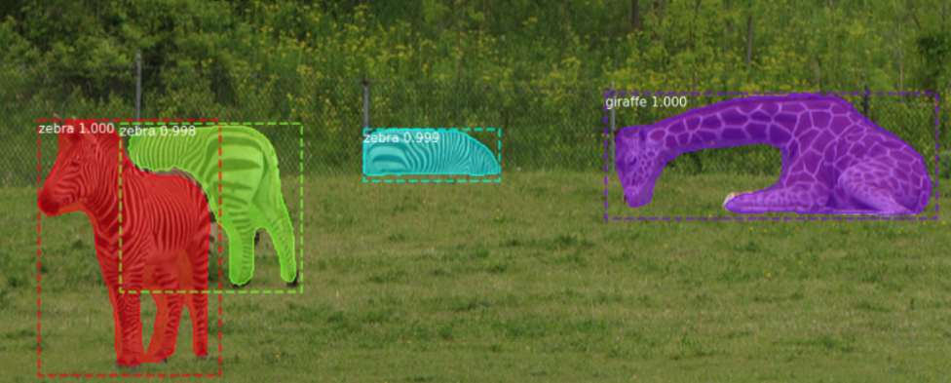
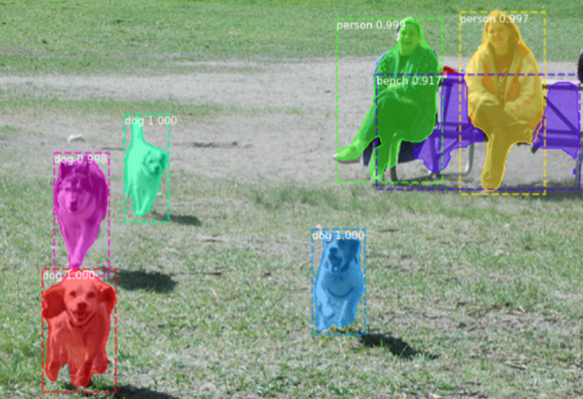
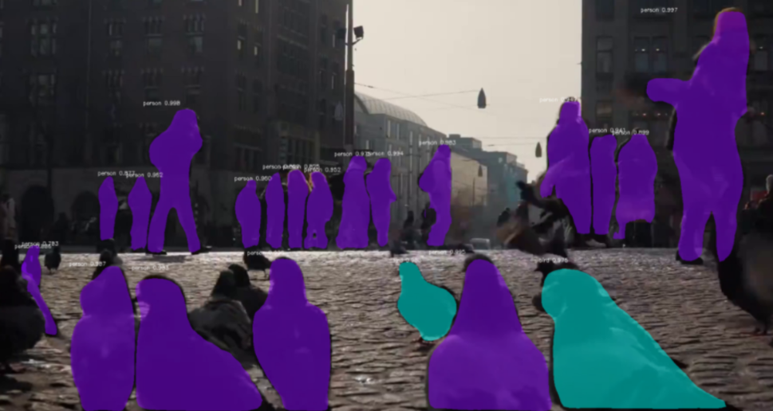
Results of Mask R-CNN

Slide 24
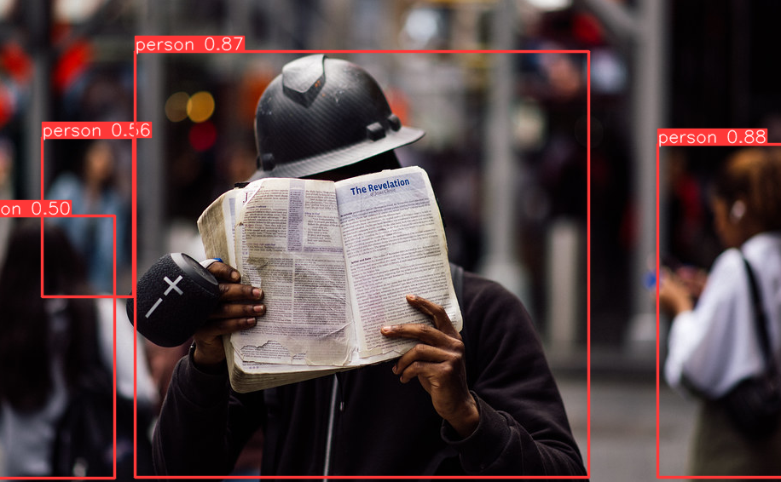
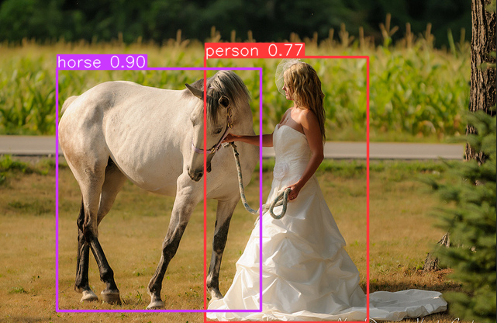
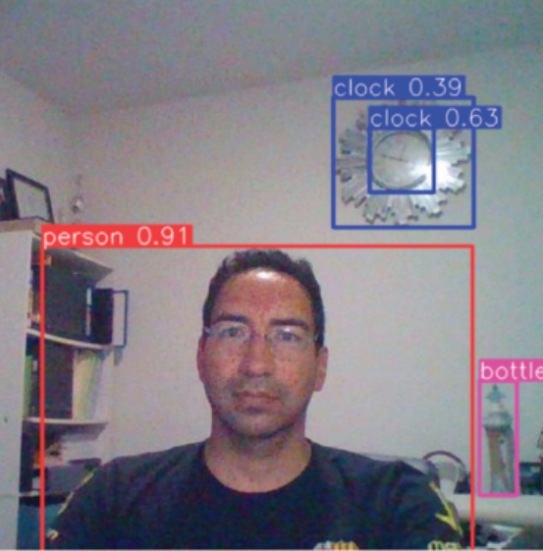
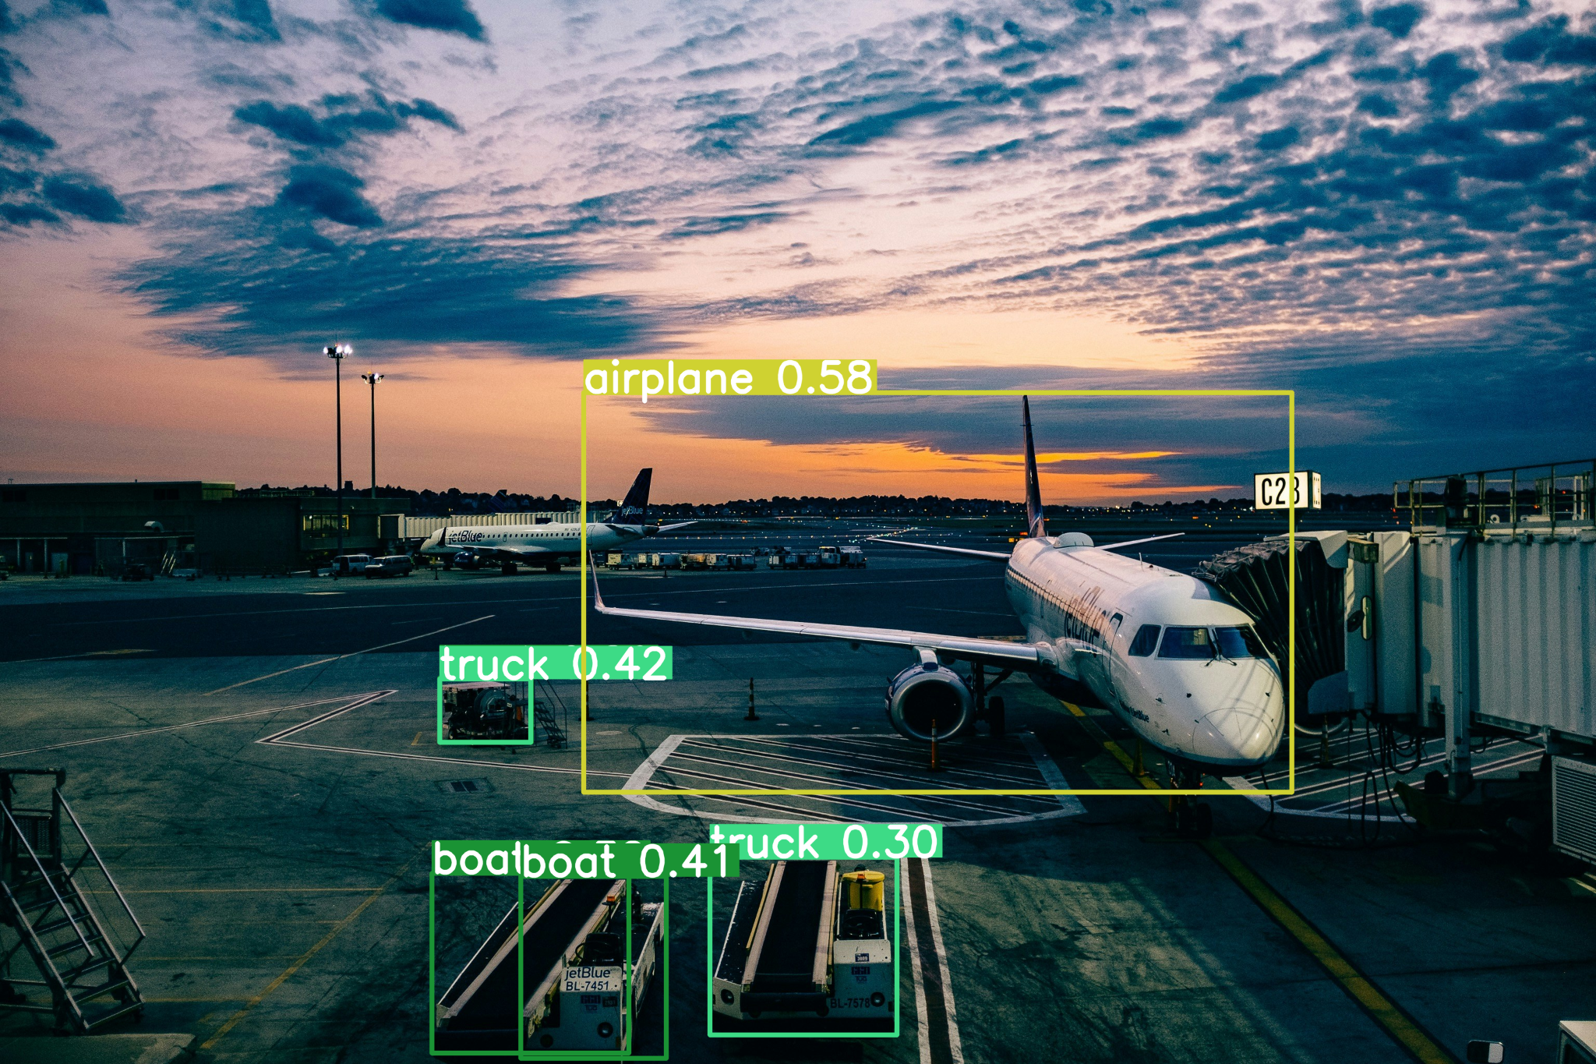
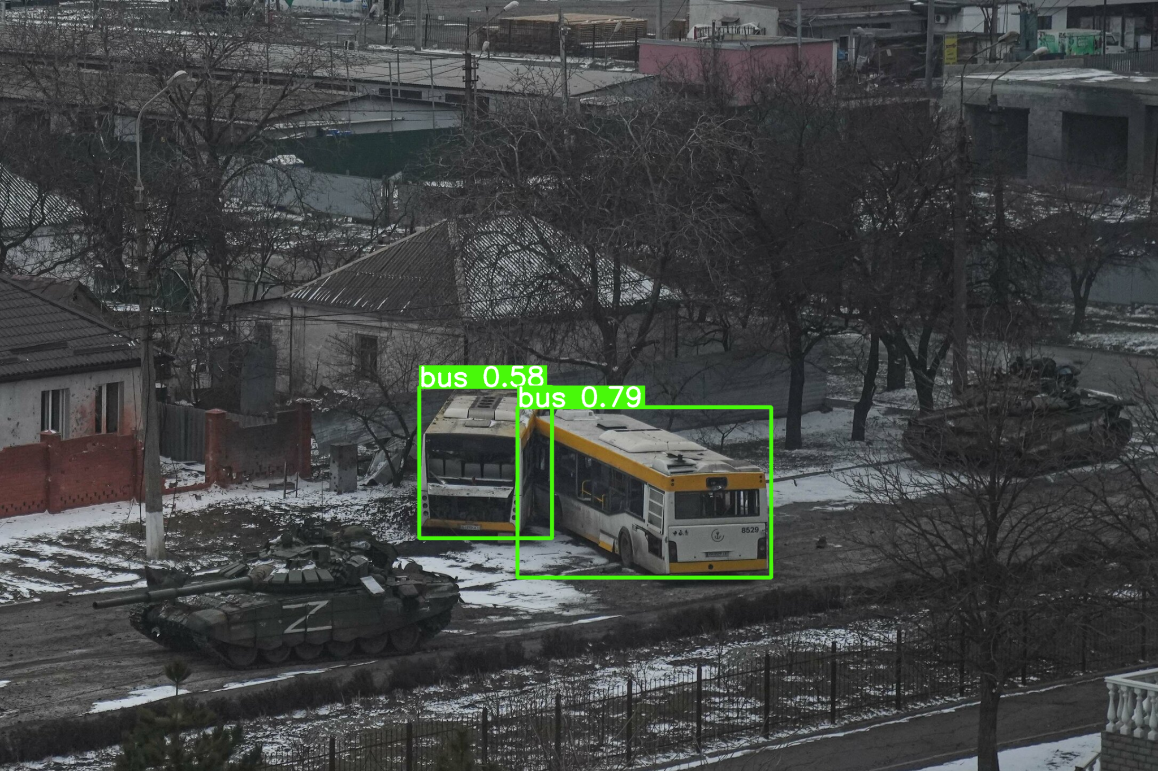
Results of YOLOv8

Slide 25
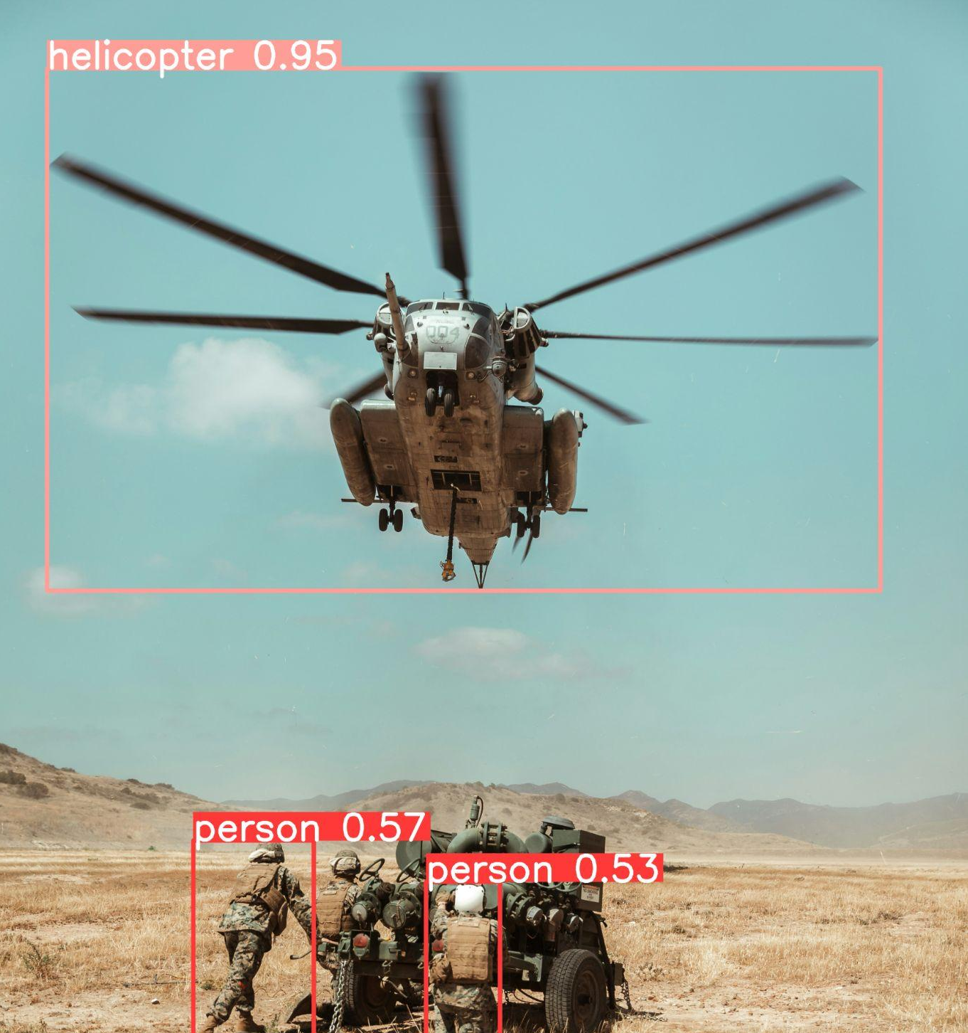
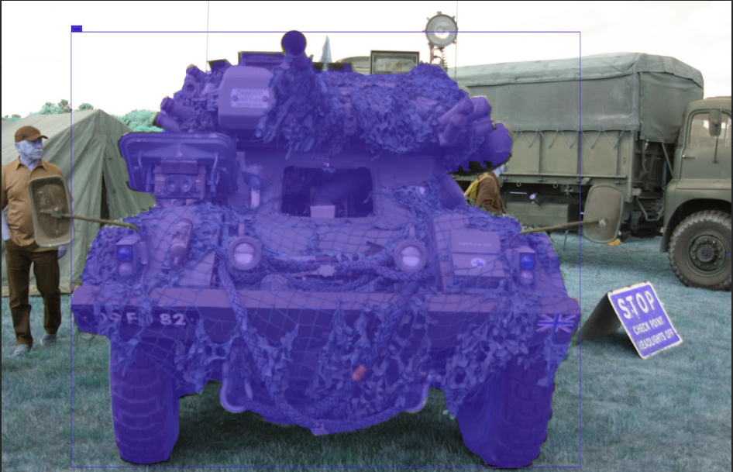
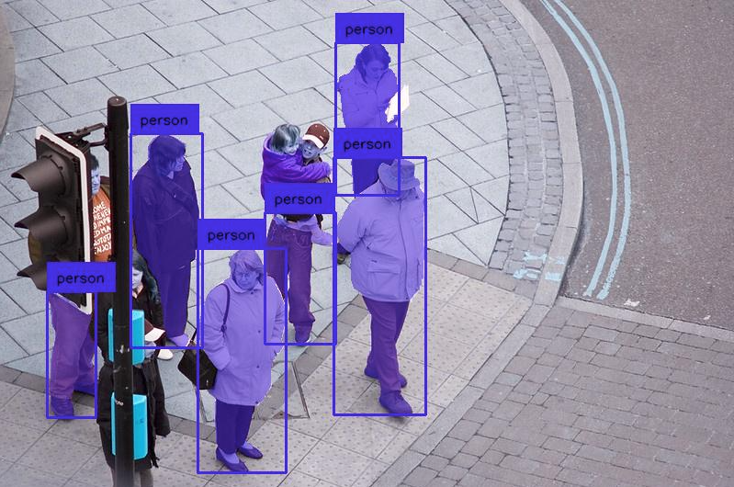
Segment Anything
SAM
YOLO-World

Slide 26
YOLOv9
Information Bottleneck
Addresses Data Loss
Reversible Function
Programmable Gradient Information (PGI)
Reliable Gradient Information
Update Network Weights
Auxiliary Reversible Branch
Generalized ELAN (GELAN)
CSPNet + ELAN
Gradient Path Planning
C. Wang, I. Yeh, and H. Liao, "YOLOv9: Learning What You Want to Learn Using Programmable Gradient Information," arXiv preprint arXiv:2402.13616v1, 2024.

Slide 27
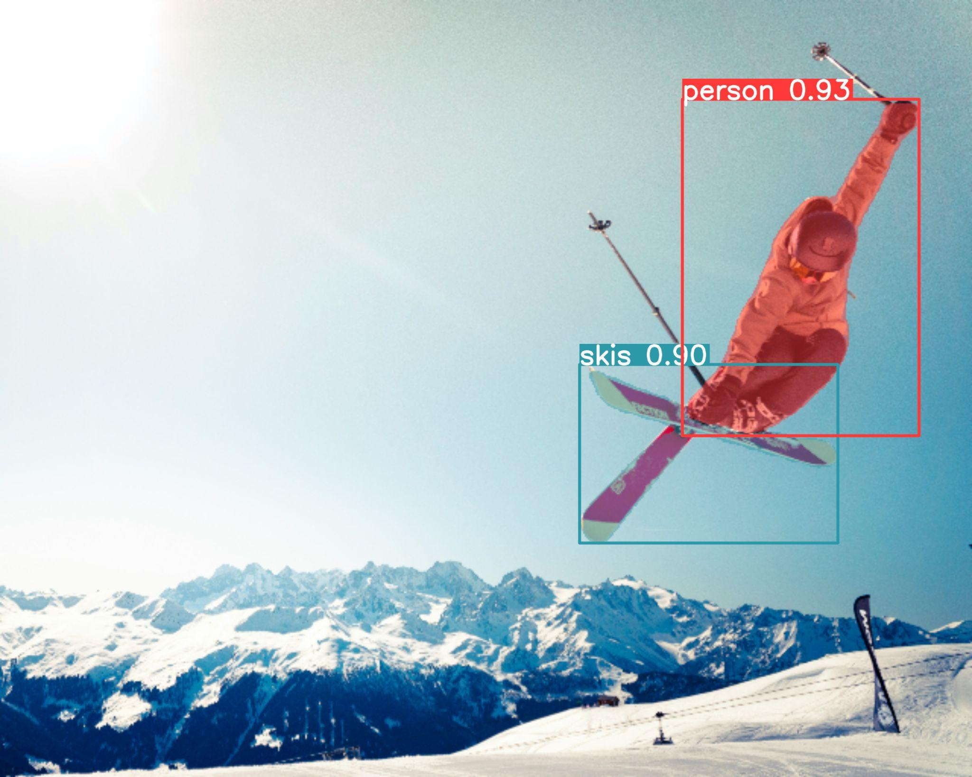
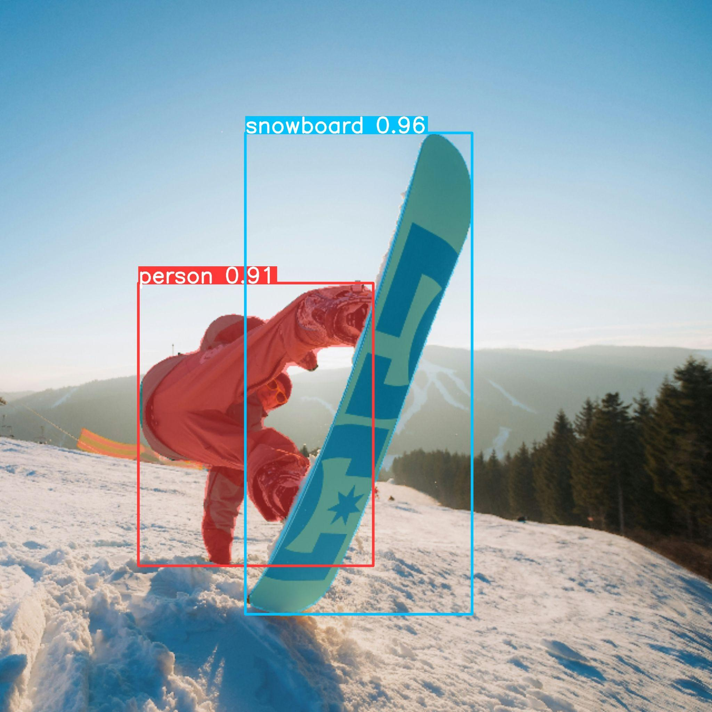
Conclusion
YOLOv8 is best for real-time
Object Detection and Segmentation
Balance in Accuracy & Speed
Faster R-CNN does not offer real-time capabilities
Mask R-CNN excels in high accuracy

Slide 28




Web Apps
Questions
RCNN-Webcam
RCNN-YOLOv8

